Slide 1
Impeachment

Slide 2
Definition
to accuse a government official of doing wrong
the first of two stages in a specific process for a legislative body to forcibly remove a government official
the second is conviction

Slide 3
Definition
The process should not be confused with a recall election
A recall election is usually initiated by voters and can be based on "political charges”
an example is mismanagement, whereas impeachment is initiated by a constitutional body (usually a legislative body) and is usually based, but not always, on indictable offenses

Slide 4
Founding
Impeachment is a British invention
In the United Kingdom, it is the House of Commons that holds the power of initiating an impeachment.
Any member may make accusations of any crime.
The member must support the charges with evidence and move for impeachment.
If the Commons carries the motion, the mover receives orders to go to the bar at the House of Lords and to impeach the accused "in the name of the House of Commons, and all the commons of the United Kingdom.“
However, impeachment has not been used for over two hundred years (the last impeachment trial was of Henry Dundas, 1st Viscount Melville in 1806).

Slide 5
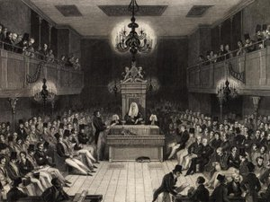
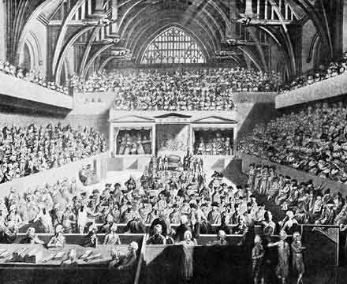

Slide 6
Founding
The hearing resembles an ordinary trial: both sides may call witnesses and present evidence.
At the end of the hearing the lords vote on the verdict, which is decided by a simple majority, one charge at a time.
Upon being called, a lord must rise and declare "guilty, upon my honour" or "not guilty, upon my honour".
After voting on all of the articles has taken place, and if the Lords find the defendant guilty, the Commons may move for judgment; the Lords may not declare the punishment until the Commons have so moved.
The Lords may then decide whatever punishment they find fit, within the law.
A royal pardon cannot excuse the defendant from trial, but a pardon may reprieve a convicted defendant

Slide 7
Level of Impeachment
In the United States, impeachment can occur both at the federal and state level.
The Constitution defines impeachment at the federal level and limits impeachment to "The President, Vice President, and all civil officers of the United States" who may only be impeached and removed for "treason, bribery, or other high crimes and misdemeanors.”
Several commentators have suggested that Congress alone may decide for itself what constitutes an impeachable offense.
In 1970, then-House Minority Leader Gerald R. Ford defined the criteria as he saw it: "An impeachable offense is whatever a majority of the House of Representatives considers it to be at a given moment in history."

Slide 8
Level of Impeachment
Article III of the Constitution states that judges remain in office "during good behavior," implying that Congress may remove a judge for bad behavior via impeachment. Whether this is the only method available to remove judges is a subject of controversy. The House has impeached 13 federal judges and the Senate has convicted six of them

Slide 9
Impeachment Proceedings
The impeachment-trial procedure is in two steps.
The House of Representatives must first pass "articles of impeachment" by a simple majority
Upon their passage, the defendant has been "impeached."
Next, the Senate tries the accused.
In the case of the impeachment of a President, the Chief Justice of the United States presides over the proceedings.

Slide 10
Impeachment Proceedings
Otherwise, the Vice President, in his capacity as President of the Senate, or the President pro tempore of the Senate presides.
This may include the impeachment of the Vice President, although legal theories suggest that allowing a person to be the judge in the case where she or he was the defendant would be a blatant conflict of interest.
If the Vice President did not preside over an impeachment (of someone other than the President), the duties would fall to the President Pro Tempore.

Slide 11
Impeachment Proceedings
In order to convict the accused, a two-thirds majority of the senators present is required.
Conviction automatically removes the defendant from office. Following conviction, the Senate may vote to further punish the individual by barring them from holding future federal office (either elected or appointed).
Despite a conviction by the Senate, the defendant remains liable to criminal prosecution.
It is possible to impeach someone even after the accused has vacated their office in order to disqualify the person from future office or from certain emoluments of their prior office (such as a pension).
If there is no charge for which a two-thirds majority of the senators present vote "Guilty", the defendant is acquitted and no punishment is imposed

Slide 12
U.S. Impeachments
Congress regards impeachment as a power to be used not only in extreme cases; the House has initiated impeachment proceedings only 62 times since 1789 (most recently against President Bill Clinton), and only the following 16 federal officers have been impeached:
Two presidents:
Andrew Johnson was impeached in 1868 after violating the then-newly created Tenure of Office Act.
President Johnson was acquitted of all charges by a single vote in the Senate.

Slide 13
U.S. Impeachments
Bill Clinton was impeached on December 19, 1998 by the House of Representatives on articles charging perjury (specifically, lying to a Federal Grand Jury (by a 228–206 vote) and obstruction of justice (by a 221–212 vote).
Other articles of impeachment failed to be approved by the House of Representatives.
One was a count of perjury in the Paula Jones civil deposition in her private sexual harassment lawsuit against President Clinton (by a 205–229 vote), and an article which accused President Clinton of abuse of power (by a 48–285 vote).
The Senate acquitted President Clinton of all charges.

Slide 14
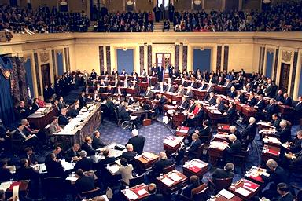
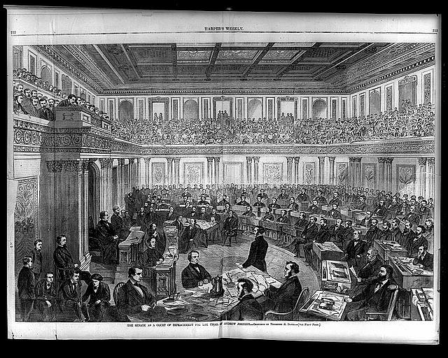

Slide 15
U.S. Impeachments
One cabinet officer, William W. Belknap (Secretary of War). He resigned before his trial, and was later acquitted. Allegedly most of those who voted to acquit him believed that his resignation had removed their jurisdiction.
One Senator, William Blount (though the Senate had already expelled him).
Associate Justice Samuel Chase in 1804.

Slide 16
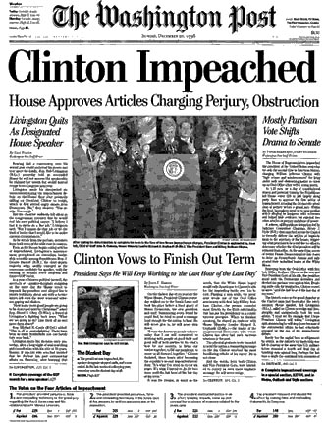

Slide 17
U.S. Impeachments
Twelve other federal judges, including Alcee Hastings, who was impeached and convicted for taking over $150,000 in bribe money in exchange for sentencing leniency.
The Senate did not bar Hastings from holding future office, and Hastings won election to the House of Representatives from South Florida.
Hastings' name was mentioned as a possible Chairman of the House Permanent Select Committee on Intelligence, but was passed over by House Speaker-designate Nancy Pelosi, presumably because of his previous impeachment and removal. Source U.S. Senate

Slide 18
U.S. Impeachments
Many mistakenly assume Richard Nixon was impeached.
While the House Judiciary Committee did approve articles of impeachment against him and did report those articles to the House of Representatives, Nixon resigned prior to House consideration of the impeachment resolutions and was pardoned by President Ford.

Slide 19
